Slide 1





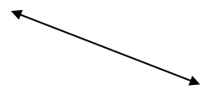


Arhitektura KP sistema
BANKING MICROSERVICE
BANKING MS DB
LU
PAYPAL MICROSERVICE
PAYPAL MS DB
API GATEWAY
BITCOIN MICROSERVICE
BITCOIN MS DB
DISCOVERY SERVICE
PAYMENT INFO MICROSERVICE
PAYMENT INFO MS DB

